Slide 1
REINFORCEMENT PROJECT-SQL
Surya V
12.12.2024
Data analytics & Data science
Oct 2024 (Regular)

Slide 2
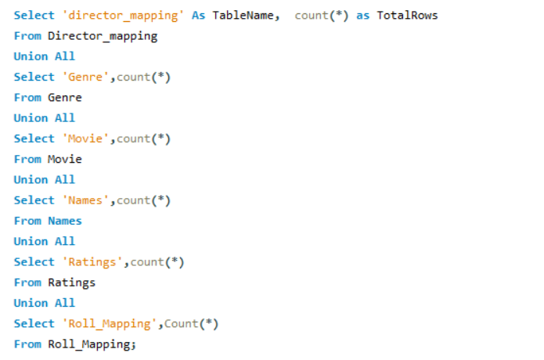
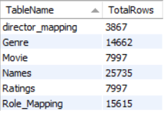
Find the total number of rows in each table of the schema.
QUERY
OUTPUT

Slide 3
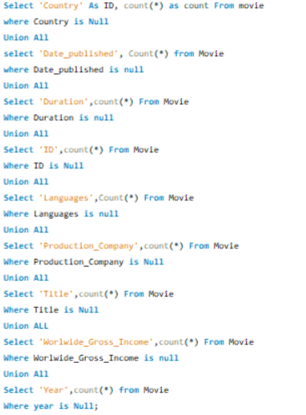
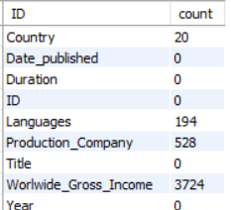
2.Which columns in the movie table have null values?
OUTPUT
QUERY

Slide 4
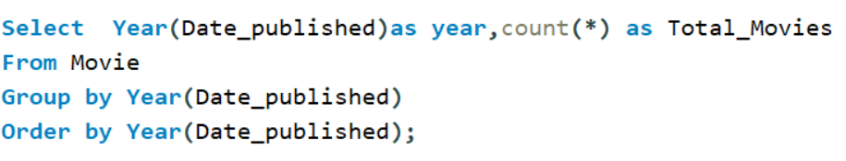
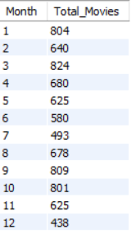
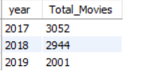
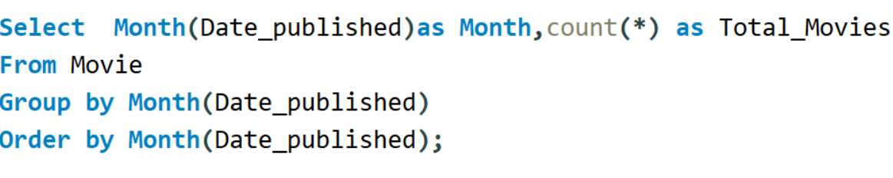
3.Find the total number of movies released each year . How does the trend look-month wise.
QUERY
OUTPUT

Slide 5
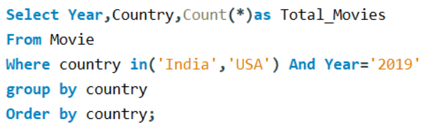

4. How many movies were produced in the USA or India in the year 2019?
QUERY
OUTPUT

Slide 6
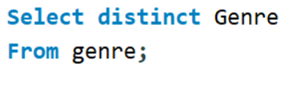
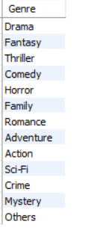

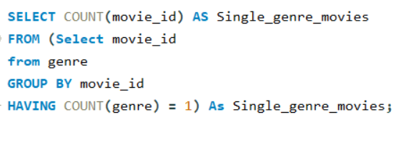
5.Find the unique list of genres present in the dataset and how many movies belongs to only one genre?
QUERY
OUTPUT

Slide 7
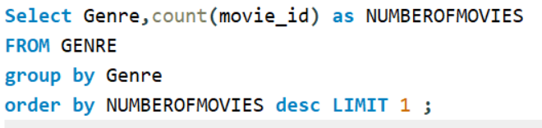

6.Which genre had the highest number of movies produced overall?
QUERY
OUTPUT

Slide 8
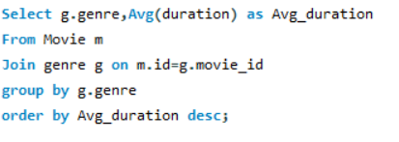
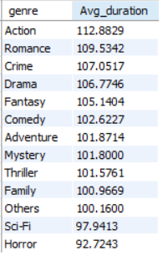
7.What is the average duration of movies in each genre?
QUERY
OUTPUT

Slide 9
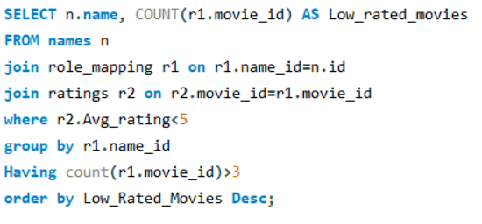
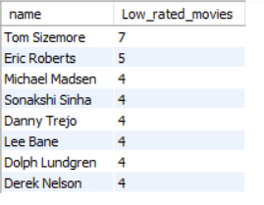
8.Identify actors or actresses who have worked in more than three movies with an average rating below 5?
QUERY
OUTPUT

Slide 10
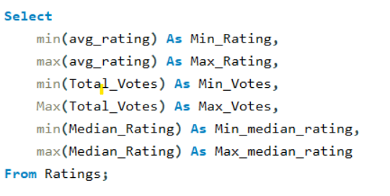

9.Find the minimum and maximum values in each column of the ratings table except the movie _ id column.
QUERY
OUTPUT

Slide 11
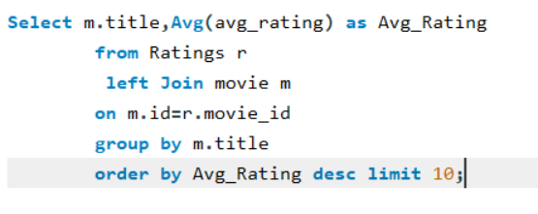
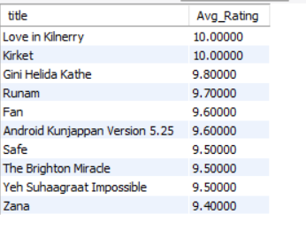
10. Which are the top 10 movies based on average rating?
QUERY
OUTPUT

Slide 12
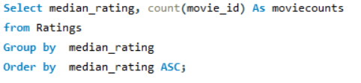
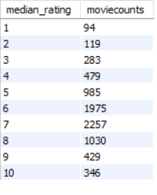
11.Summarise the ratings table based on the movie counts by median ratings.
QUERY
OUTPUT

Slide 13
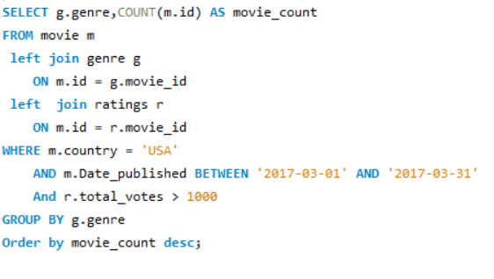
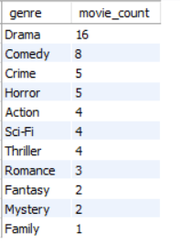
12.How many movies released in each genre during March 2017 in the USA had more than 1,000 votes?

Slide 14
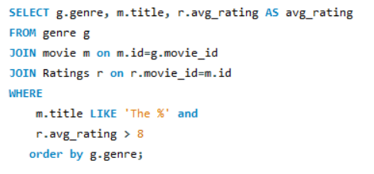
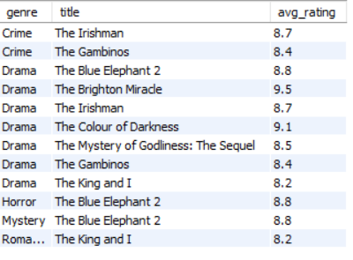
13.Find movies of each genre that start with the word ‘The ’ and which have an average rating > 8.
QUERY
OUTPUT

Slide 15
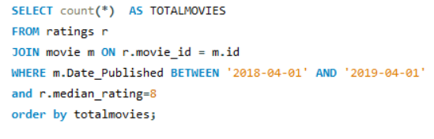

14.Of the movies released between 1 April 2018 and 1 April 2019, how many were given a median rating of 8?
QUERY
OUTPUT

Slide 16
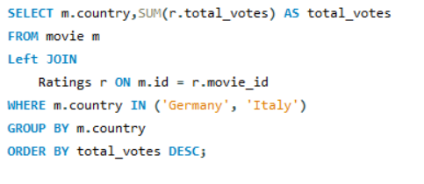

15.Do German movies get more votes than Italian movies?
QUERY
OUTPUT

Slide 17
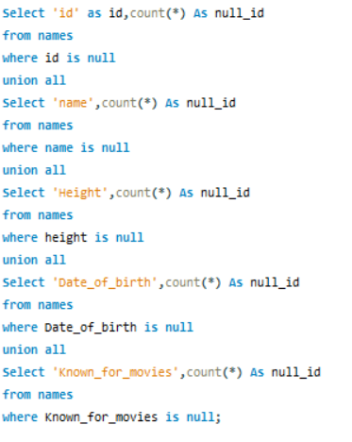
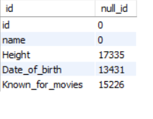
16.Which columns in the names table have null values?
QUERY
OUTPUT

Slide 18
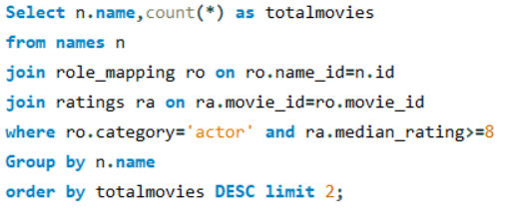

17.Who are the top two actors whose movies have a median rating >= 8?
QUERY
OUTPUT

Slide 19
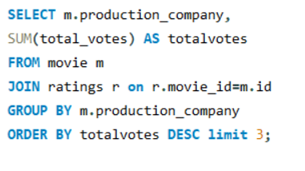
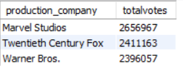
18.Which are the top three production houses based on the number of votes received by their movies?
QUERY
OUTPUT

Slide 20
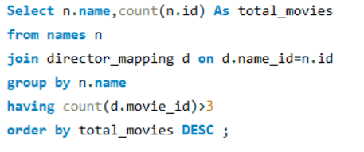
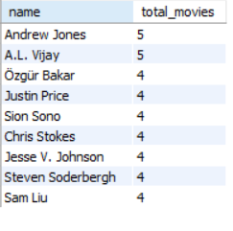
19.How many directors worked on more than three movies?
QUERY
OUTPUT

Slide 21
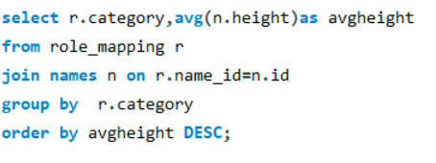

20.Find the average height of actors and actresses separately.
QUERY
OUTPUT

Slide 22
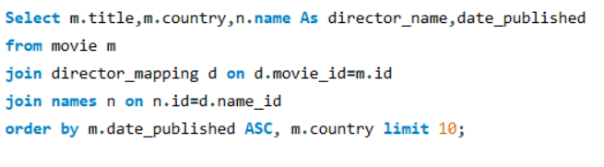
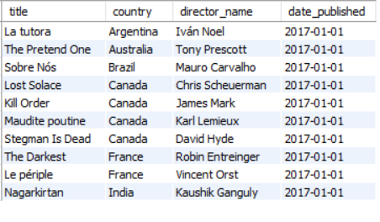
21.Identify the 10 oldest movies in the dataset along with its title, country, and director.
QUERY
OUTPUT

Slide 23
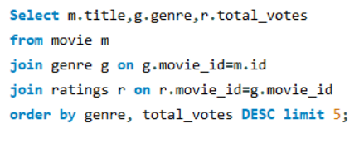
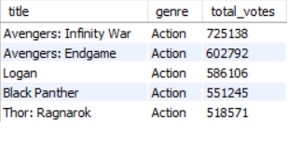
22.List the top 5 movies with the highest total votes and their genres
QUERY
OUTPUT

Slide 24
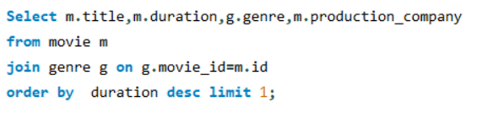

23.Find the movie with the longest duration, along with its genre and production company.
QUERY
OUTPUT

Slide 25
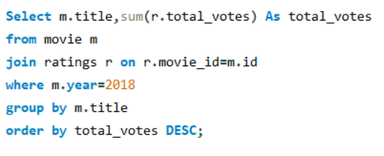
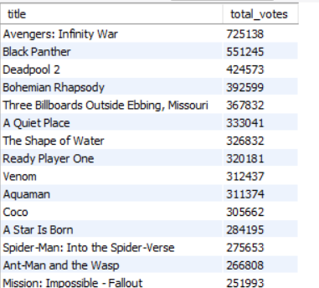
24.Determine the total votes received for each movie released in 2018.
QUERY
OUTPUT

Slide 26
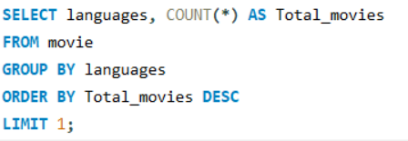

25.Find the most common language in which movies were produced.
QUERY
OUTPUT

Slide 27
INSIGHTS AND CONCLUSION
Highest movies released year – 2017 and Month - March
Lowest movies released Year – 2019 and Month – December
Highest movie released genre – Darma
Lowest movie released genre – Family
Highest Duration – La -flor 808

Slide 28
Thank You

